Slide 1
Are You My Mother?

Slide 2
Are You My Mother? By P.D. Eastman is a very popular children’s book
In it a baby bird wanders in search of his mother
The baby bird meets many animals and things, but not one is his mother
Finally, he is united with his mother and the baby bird is happy

Slide 3
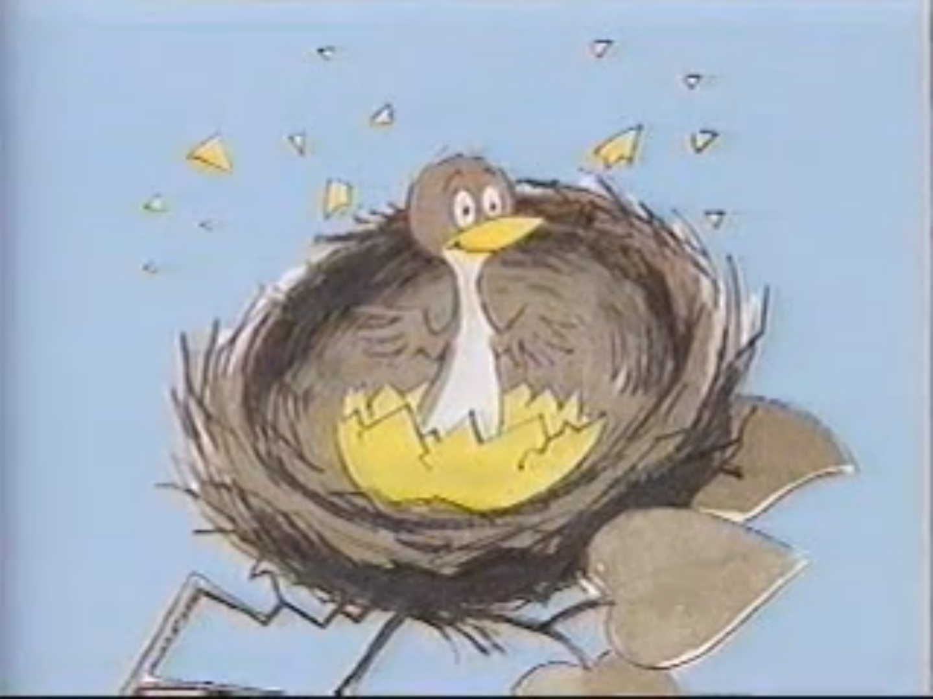
An Important Question
Most people have a deep need to belong and to fit into the world about them
Children most often find that connection via their parents, especially their mother

Slide 4
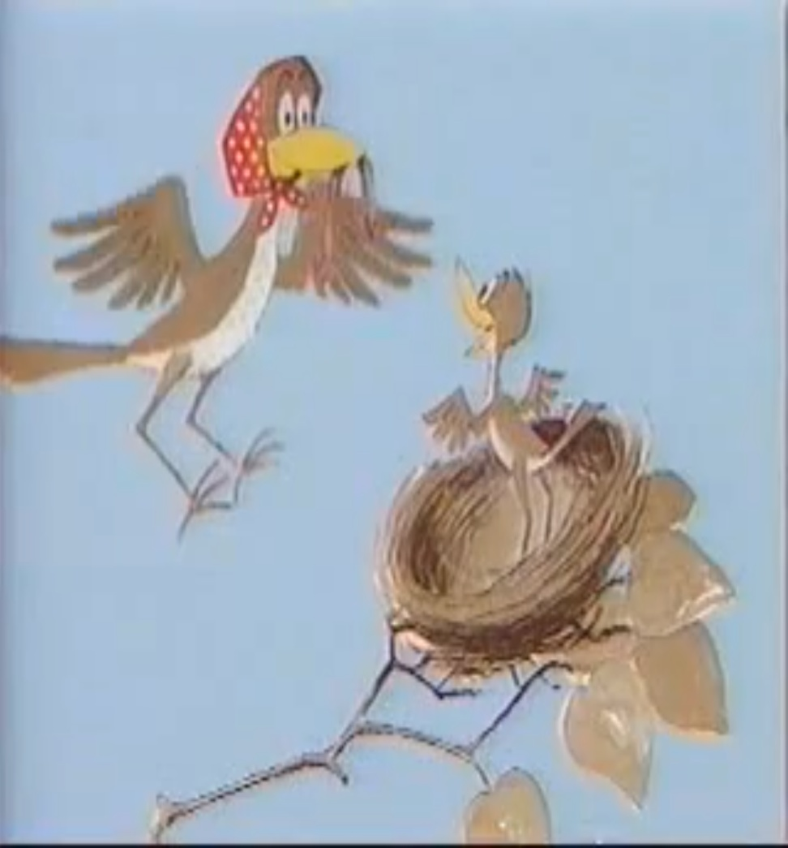
A Completing Answer
Mothering is incredibly important to a child
A mom’s nurture is more desired than even food
A mother is a child’s port of entry into reality

Slide 5
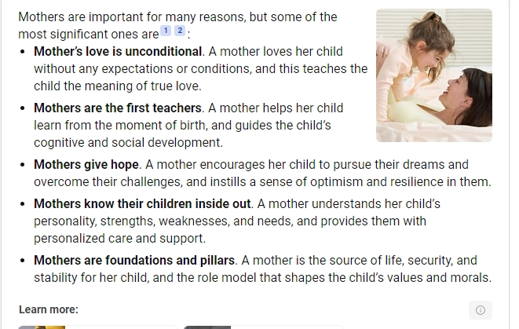
A Formative Relationship

Slide 6
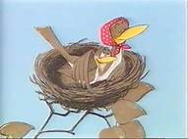
Thank You, Mom!

Slide 7
Did You Know that the Bible Teaches that We All Share the Same Mother?

Slide 8
Context
Galatians: Paul’s letter to a floundering church in central Turkey
Paul had planted this church
Jewish traditionalists had followed Paul and subverted these converts become Jews to follow Jesus

Slide 9
More Context
These Jewish Christians insisted the spiritually immature Gentile Christians be circumcised & keep Jewish Law & rites
Paul condemned these “Judaizers” for attacking the very essence of the Gospel
Paul asserted that righteousness comes by faith in Christ – NOT by the Torah

Slide 10
Paul’s Allegory of 2 Mothers
Hagar
Sarah
Bondwoman
Bore a Son of the Flesh (Ishmael)
Covenant of Law that produces slaves
Worldly Jerusalem
Less Children
Free Woman
Bore a Son of God’s promise (Isaac)
Covenant of Grace that produces free men and women
Heavenly Jerusalem
More Children

Slide 11
Paul’s Supporting Scripture
“Rejoice barren woman who does not bear! Break forth and shout you who are not in labor; for more are the children of the desolate than of the one who has a husband!”
(Isaiah 54:1)

Slide 12
Paul’s Supporting Scripture
“Cast out the bondwoman and her son, for the son of the bondwoman shall not be an heir with the son of the free woman.”
(Genesis 21:10)

Slide 13
Our Mutual Mother
We too are children of Sarah (vs. 26)
Jerusalem above is also our Mother (vs. 26)
We too are children of God’s promise (vs. 28)
We too are persecuted by the children of the flesh (vs. 29) as Ishmael persecuted Isaac
Via the free woman we are heirs as well as her children (vs. 30-31)

Slide 14
Differences that Matter
The Law
True Gospel
Revelatory
Rule-keeping
Works
Death’s Curse
Condemnation
Bound Slaves
God’s Work/Will
Grace
Faith
Blessing of Life
Exoneration
Adopted Children

Slide 15
Differences that Matter
The Law
True Gospel
Defeat
Old Covenant
Walk in the Flesh
Fleshly Works
No grace/Falling from Grace
Boasting in Self
Victory
New Covenant
Walk in the Spirit
Fruits of the Spirit
Standing Firm in Grace
Boasting in Jesus

Slide 16
Then and Now…
In Paul’s day he faced ardent zealots who claimed to follow Christ but led believers away from the freedom of the Gospel back into slavery under the Law

Slide 17
Then and Now…
In our day we face ardent zealots who claim to follow Christ but are leading the Church away from the freedom of the Gospel into slavery to sin by embracing sin as virtue and calling that embrace of sin freedom

Slide 18
Differences Still Matter
New Fake Gospel
True Gospel
Human Thought
Socio/Political Beliefs & Actions
Death Remains
Sin is Subjective
Remain Slaves to Sin
God’s Revelation
Grace
Faith
Life is Gifted to Us
Exoneration
Adopted Children

Slide 19
Differences Still Matter
New Fake Gospel
True Gospel
Self-Deception
Covenant w/Self
Exalts and Indulges the Flesh
Grace = No Limits on human behavior
Boasting in Self/Sin
Victory
New Covenant
Walk in the Spirit
Fruits of the Spirit
Standing Firm in Biblical Grace
Boasting in Jesus

Slide 20
Such Apostasy Was Foretold
Paul commanded Timothy:
“I solemnly charge you… preach the word; be ready in season and out of season; reprove, rebuke, exhort, with great patience and instruction.
(II Timothy 4:1-2)

Slide 21
Why It Will Come
“For the time will come when they will not endure sound doctrine; but wanting to have their ears tickled, they will accumulate for themselves teachers in accordance to their own desires; and will turn away their ears from the truth, and will turn aside to myths.
(II Timothy 4:3-4)

Slide 22
Why It Will Come
People within church congregations:
Will not be able to stand truth-telling
Will irrationally crave, lust after and long for forbidden and generally evils desires
Will seek teachers who support these longings
Will turn their backs on the truth and embrace simplistic fabrications about what is real/true (muthŏs)

Slide 23
How Should We Respond?
“…even if you should suffer for the sake of righteousness you are blessed. And do not fear their intimidation, and do not be troubled, but sanctify Christ as Lord in your hearts, always being ready to make a defense to everyone who asks you to give an account for the hope that is in you, yet with gentleness and reverence.
(I Peter 3:14-15)

Slide 24
How Should We Respond?
Remember you are blessed
Remember Jesus is in your heart
Be at peace
Be prepared
Be gentle and reverent

Slide 25
Happy Mother’s Day!

